Slide 1
“Implementation of SDR-Based Receiver using STM32 & NRF24L01”
Srinath Ravichandran
124004308
ECE/SEEE
Vijayaraghavan K B
124004361
ECE/SEEE
Dr. James A. Baskaradas
Project Guide
ECE/SEEE
SASTRA Deemed University
22-05-2024
First Review
1

Slide 2
Background and Problem Statement
Background:
In recent years, the landscape of wireless communications has rapidly evolved in such a way that the traditional Hardware radio systems struggle to keep up their pace with the demand for adaptability, new communication protocols, etc. So, a new software-defined radio system was introduced to overcome this problem.
Problem Statement:
The problem being faced is that the traditional radio systems lack evolution in flexibility to reconfiguration and adaptability to the surrounding circumstances resulting in improper or partial signal processing which Causes the presence of noise in the processed data signals.
First Review

Slide 3
Objective of the work
To execute a working model of a Software-defined Radio communication system (SDR) which is used to improve the quality of the radio communication systems rather than the traditional ones.
The SDR uses hardware such as STM32s to improve the quality and adaptability of complex signals and RF module for transmitting and receiving the signals.
nRF module – 2.5 GHz at -13dB
First Review

Slide 4
Proposed Methodology
To demonstrate a working model of a radio communication system using STM32 and RF board with the Serial Peripheral Interface.
The RF board receives the data signal from the designed antenna for a frequency of 2.4GHz and transmits it to the STM32 board.
STM32
RF24L01
VCC
CLK Div
SPI
CSN
MOSI
GND
MISO
CE
SCLK
IRQ
First Review

Slide 5
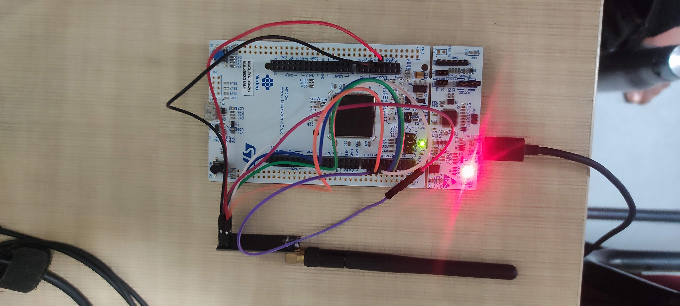
BOARD CIRCUIT DIAGRAM
First Review

Slide 6
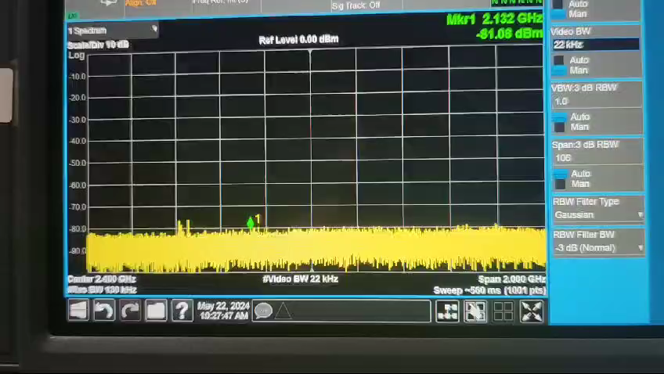
TRANSMISSION
First Review

Slide 7
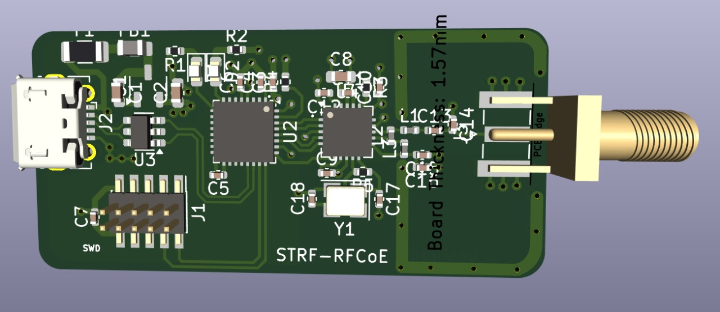
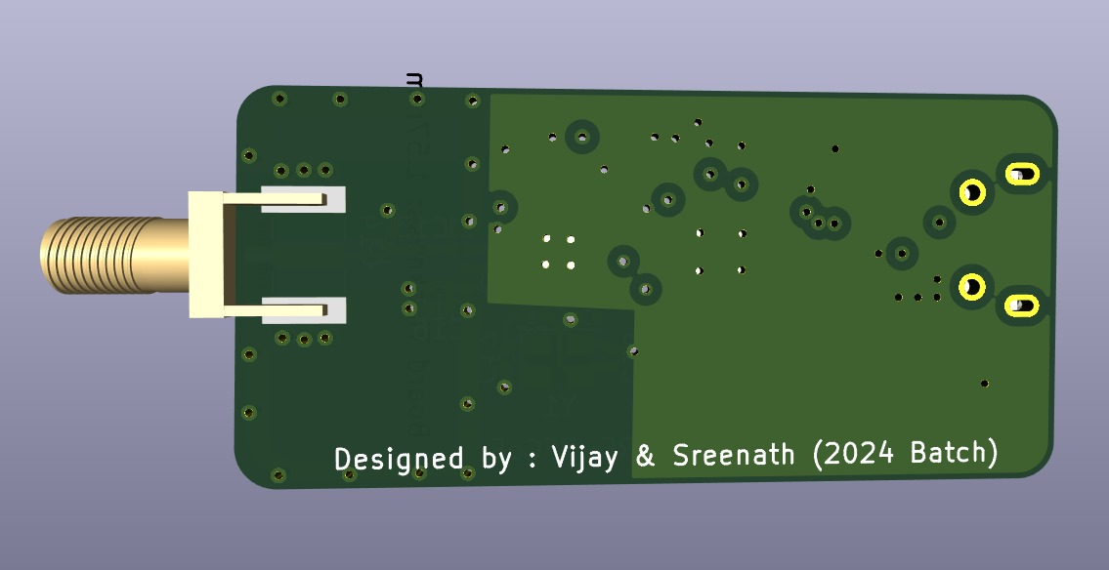
PCB DESIGN
Top view PCB Design
Bottom view PCB Design
First Review

Slide 8
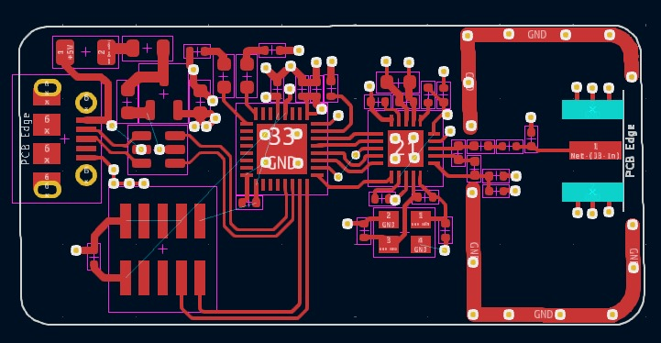
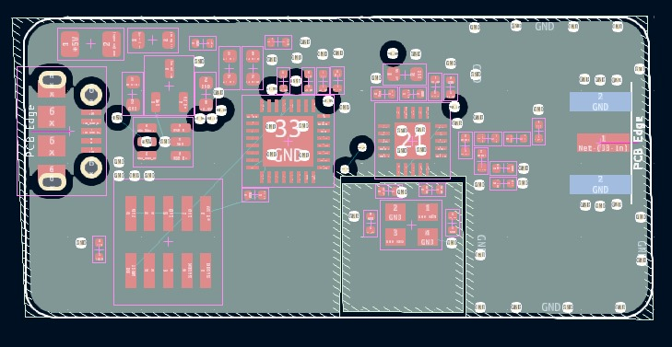
PCB LAYERS
Top Layer RF Signal
Second Layer Ground

Slide 9
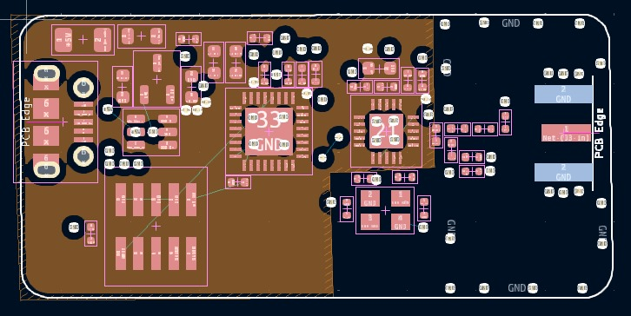
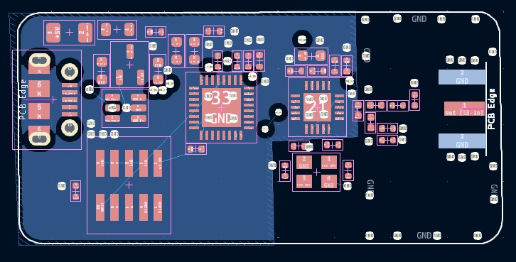
PCB LAYERS
Third Layer – Power Plane
Fourth Layer Ground

Slide 10
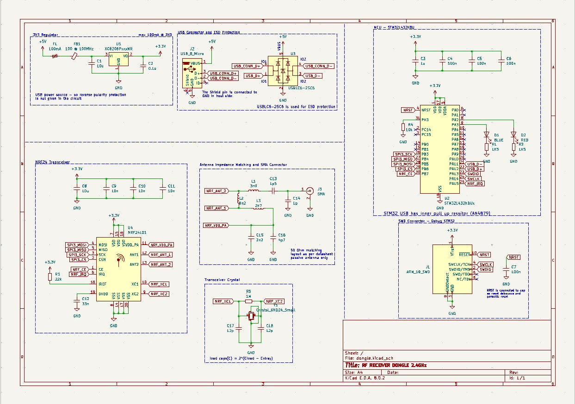
SCHEMATICS

Slide 11
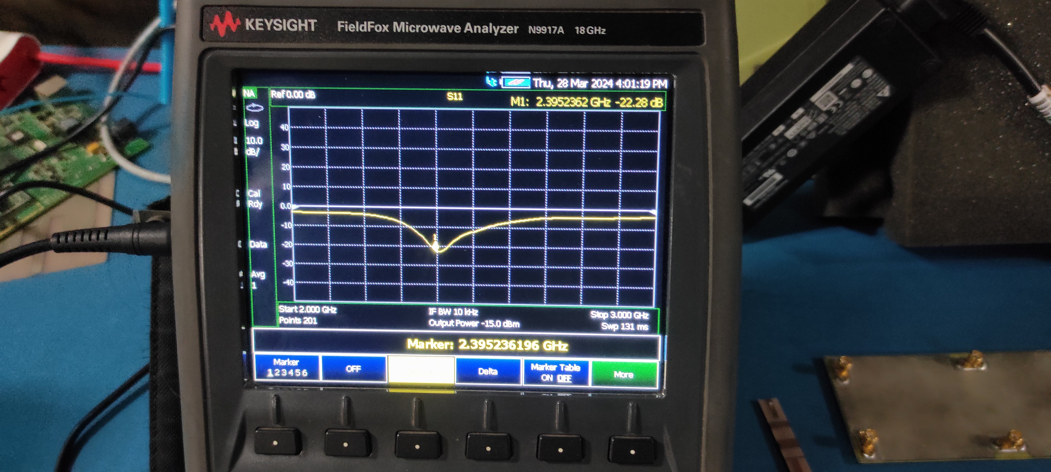
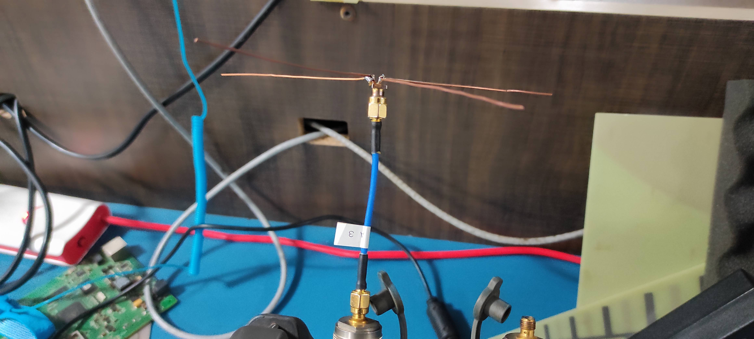
RESULT OF THE ANTENNA AT N.A.
First Review

Slide 12
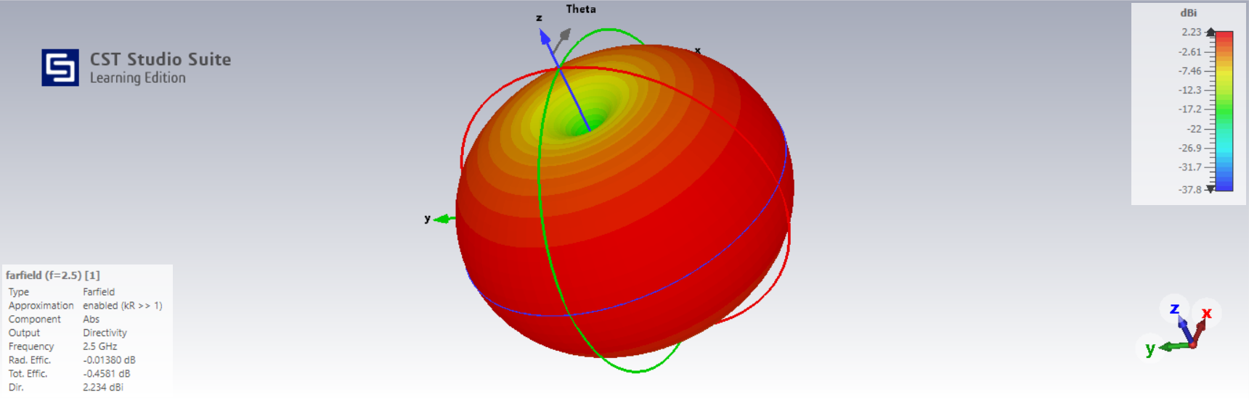
ORTHOGONAL RADIATION PATTERN
First Review

Slide 13
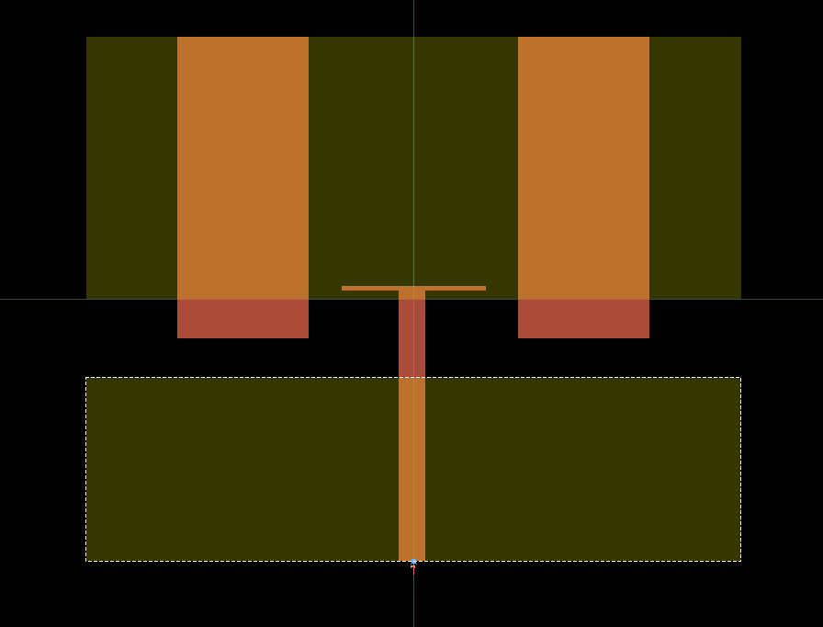
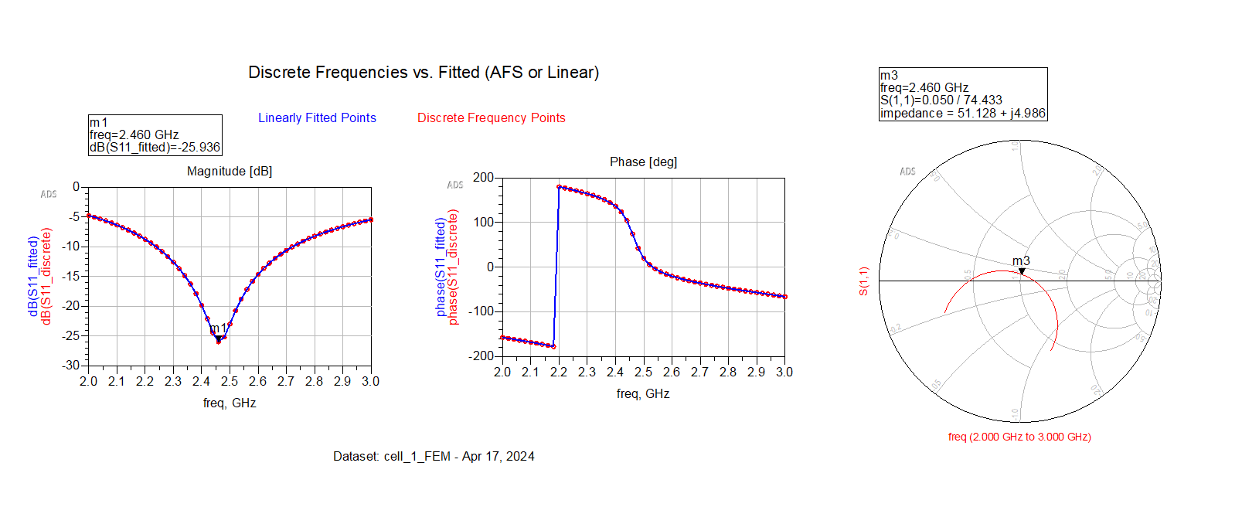
PATCH ANTENNA SIMULATION
First Review

Slide 14
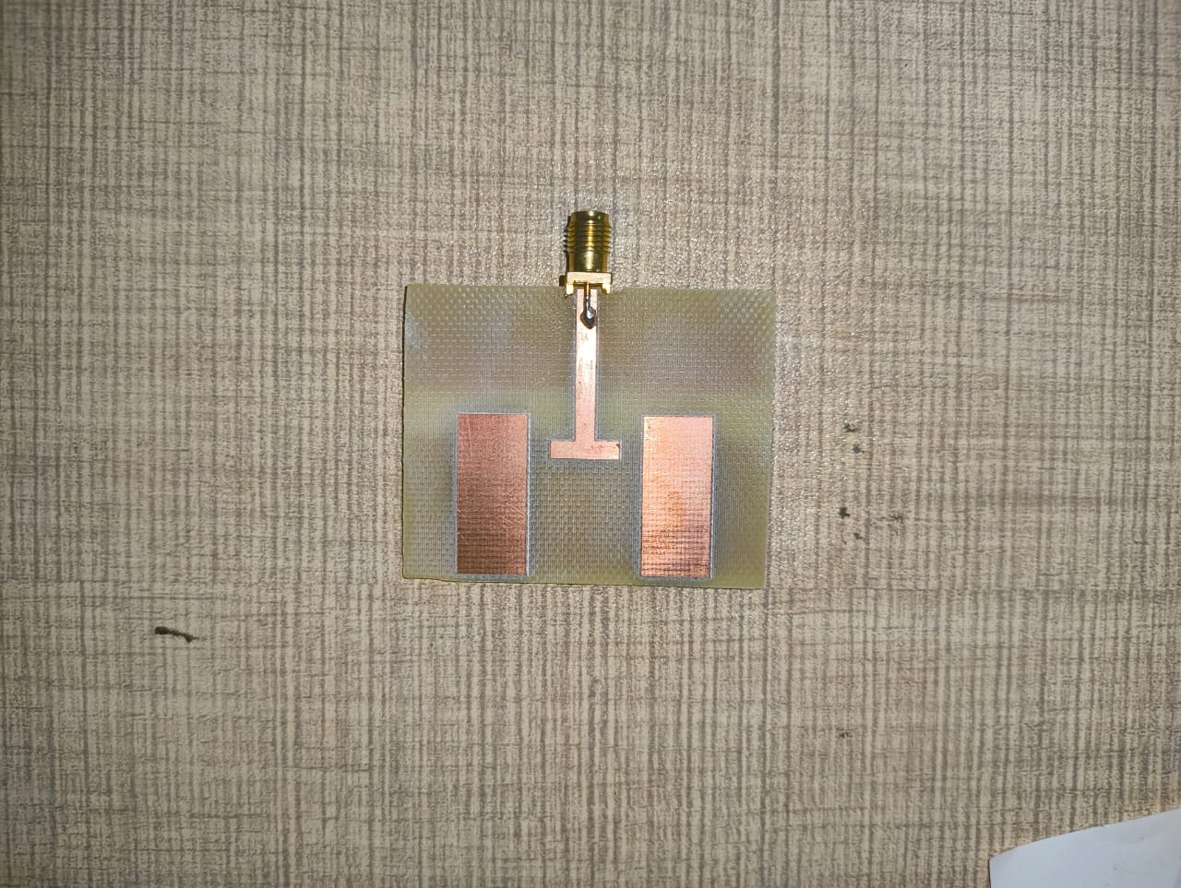
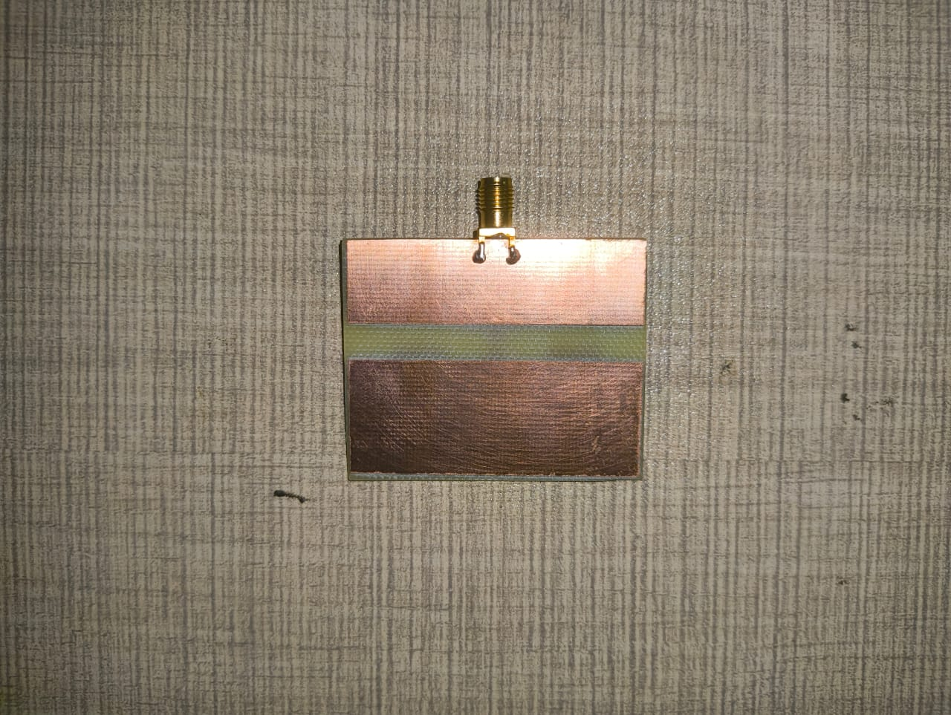
PATCH ANTENNA FABRICATION
First Review

Slide 15
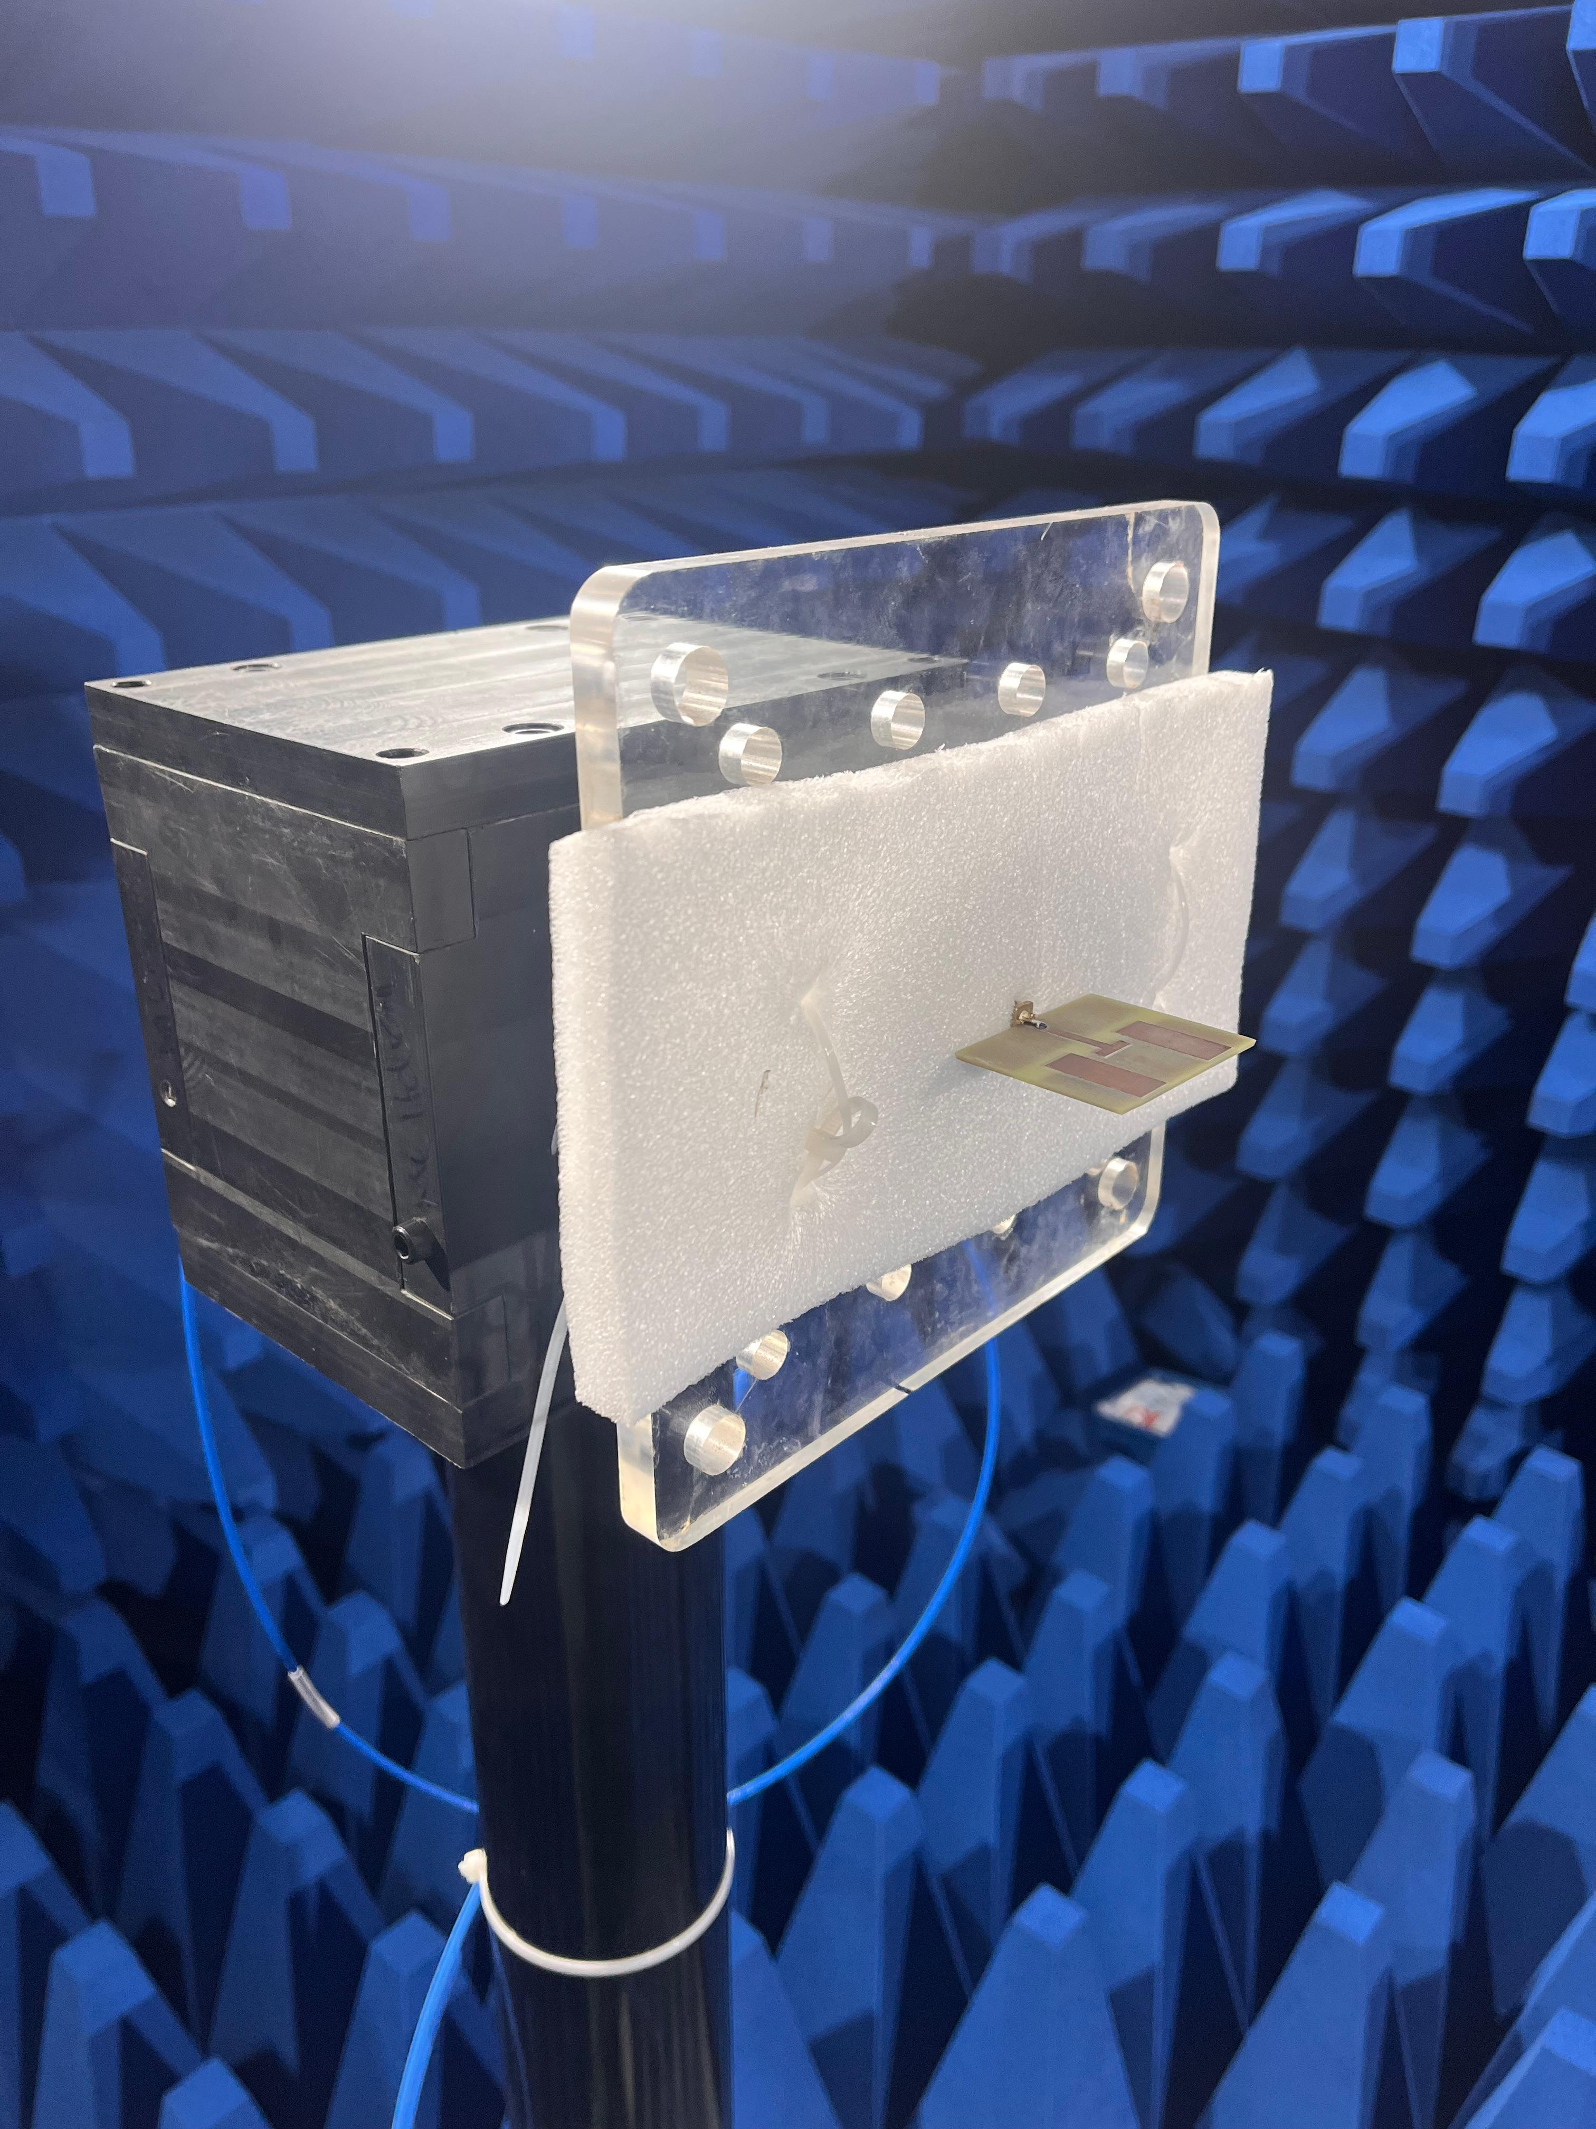
PATCH ANTENNA IN ANECHOIC CHAMBER
First Review

Slide 16
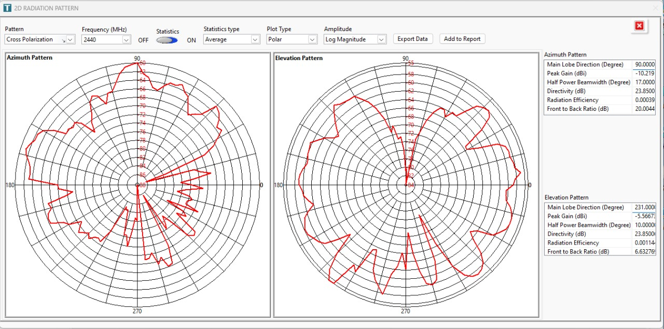
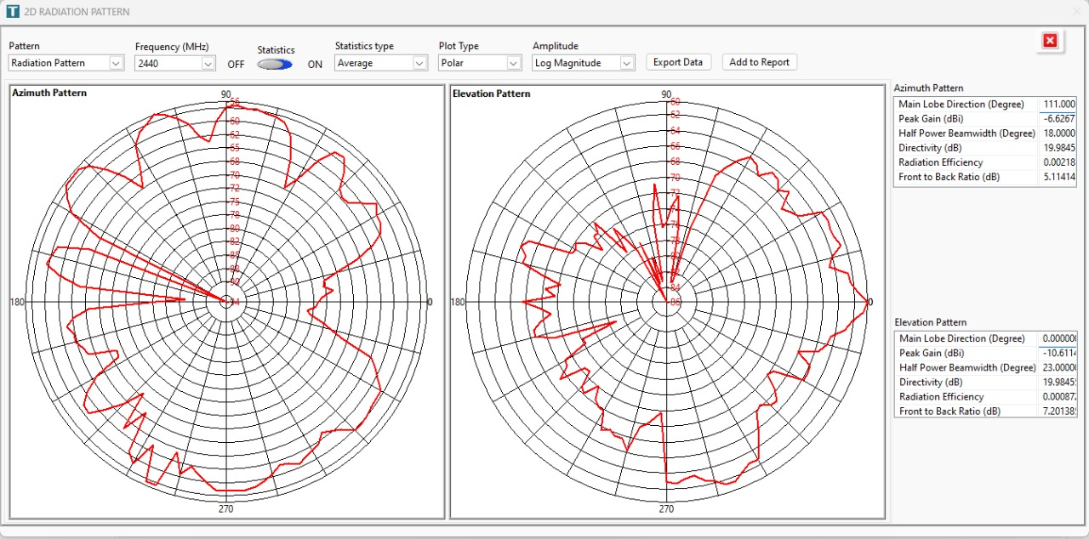
PATCH ANTENNA RADIATION PATTERN
First Review

Slide 17
Proposed Timeline
Activities/weeks | 1st week | 2nd - 3rd week | 4th - 8th week | 9th - 10th week | 11th week | 12th week | 13th week
Literature Review
Personnel’s appointment
Component Research and VHDL (SPI)
Working on Xilinx FPGA and RF Board
Interfacing
Error Identification & Correction
Validation and Documentation
Project Demo & Report submission
First Review

Slide 18
References
Anton S. Rodriguez, Michael C. Mensinger, Jr., Software defined Radio Using Xilinx.
M. L. Welborn, “Direct Waveform Synthesis for Software Radios, ”IEEE Wireless Communications and Networking Conference WCNC.1999, vol. 1, pp. 211-215, September 1999
Hiroshi Harada, Ramjee Prasad, “Simulation and Software Radio for Mobile Communications,” Artech House Publishers Bk & CD-Rom edition. pp. 90-93,2002.
K. Shahana, R. K. Gupta and K. S. Parikh, "SDR — Implementation of low-frequency trans-receiver on FPGA," 2014 International Conference on Signal Processing and Integrated Networks (SPIN), Noida, India, 2014, pp. 371-376.
First Review

